Slide 1
DAVENPORT INSTITUTE
The Dialogue between Local Government & the Community
Pooja Di Giovanna, Assistant Director
Notes:
Chat Activity: When you think about communicating with your elected officials and staff, what do you think about?

Slide 2
Roadmap
Temperature Check: Trust in Local Government
Dialogue in Public Engagement
Impact of the Pandemic
Dialogue and relationship building
Bringing it all together, why is this important?
Photo credit Pepperdine University
Notes:
Add slide introducing speakers

Slide 3
Temperature Check
Trust in Local Government

Slide 4
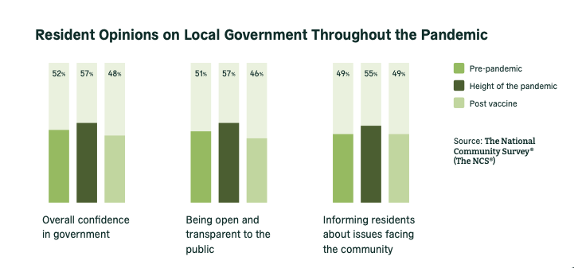
Why is Public Engagement so Important Now?
Notes:
A common saying in public engagement work is: Government moves at the speed of trust.
People’s experiences with past government interaction (promises made/kept, customer service), level of understanding of limitations (policies, laws, regulations), perceptions (personalities affect how trust is developed). Government has a vested interest in building trust in the communities we serve.

Slide 5
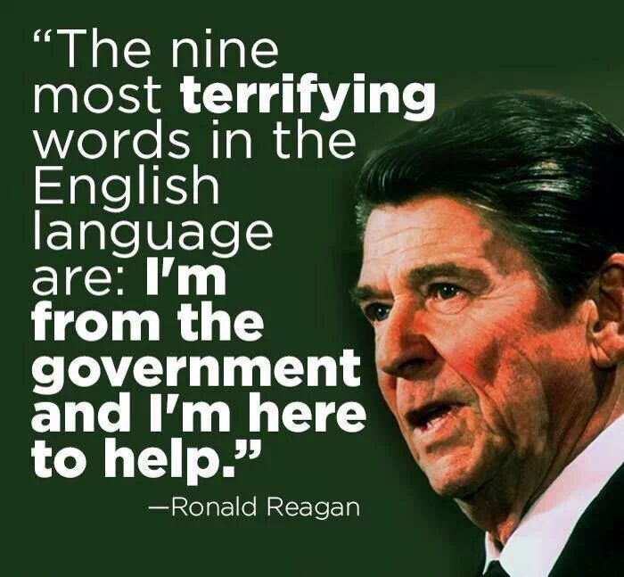
An Evolving Paradigm
Notes:
August 12, 1986 news conference During this News Conference, President Ronald Reagan refers to how the government tends to be inefficient, to such a degree that instead of helping, it often causes harm instead. This view expresses the need for a more diminutive form of government where an individual or organization can complete an activity more effectively than the whole government.
A few key points are:
Government creates unpredictability due to constantly changing policies.
The government’s goals sometimes don't align with the nation’s goals.
With this ideology, he wanted to create and organize a government of the right size for its people, where both could work in harmony to overcome the crisis.

Slide 6
From Edict to Dialogue in
Public Engagement
Approach #1: We know what’s best for you→ Paternalistic= one-way governance
Approach #2: We’re here to give you whatever you request→ Vending machine government=dissatisfaction on both ends
Approach #3: How do we work together to create the best path forward→ Collaboration through dialogue(effective public engagement) = strong communities

Slide 7
Defining Public Engagement

Slide 8
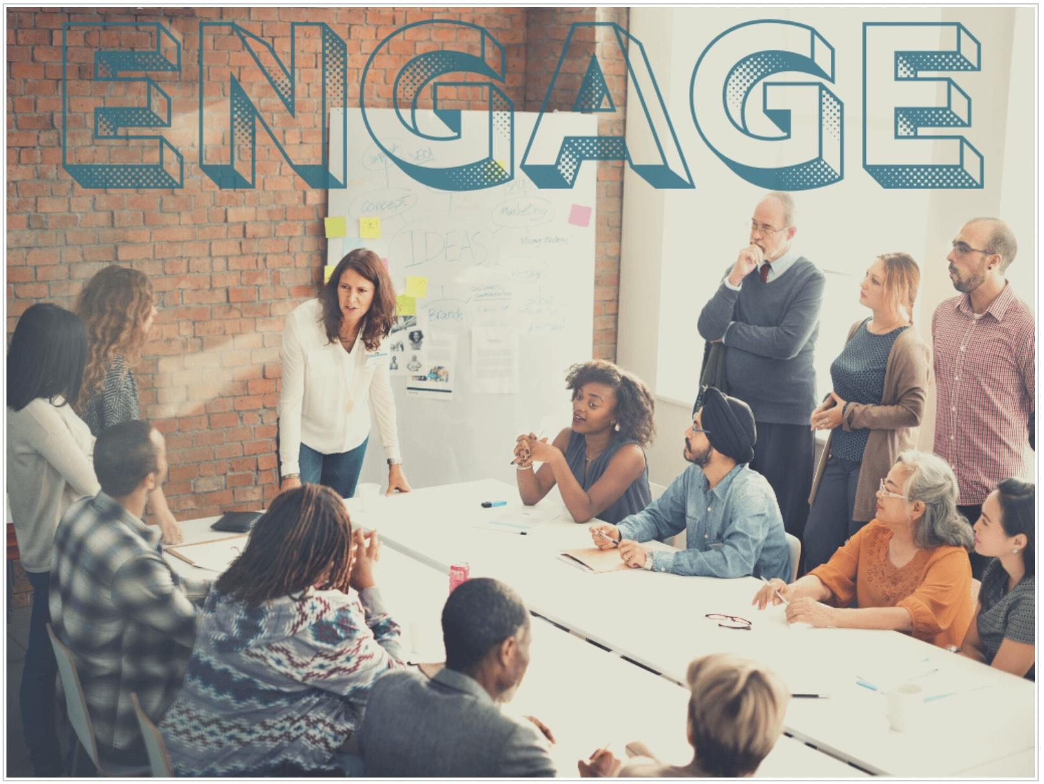
Defining Public Engagement
Public engagement is about collaborating with community members to shape solutions through dialogue. It views feedback from community members as essential to the decision making process.
This leads to a greater degree of trust between the public and local government, the building of authentic relationships, and project success.
Photo credit: University of Delaware

Slide 9
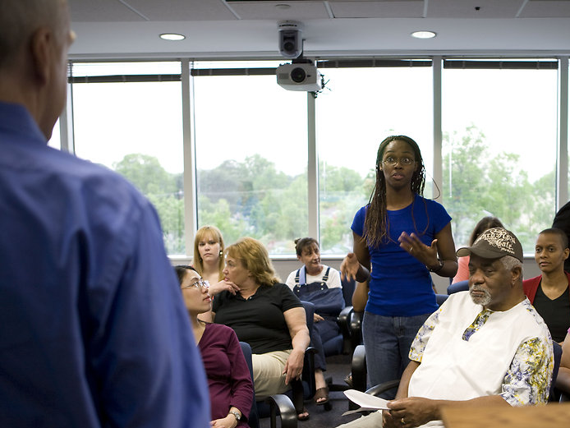
Public Engagement
Active, never passive
Built upon relationships
Focused on including the community in the decision making process
Collaborative process
Requires follow-up
Focused on who to listen to and how to incorporate that feedback

Slide 10
The Foundations of Public Engagement
Effective, dialogue focused public engagement
Trust Building
Strong Communities
Notes:
the foundations of public engagement to emphasize the role effective dialogue plays in relationship building. We will be looking at the how in between the first two circles.

Slide 11
Impact of the Pandemic on Public Engagement & Dialogue

Slide 12
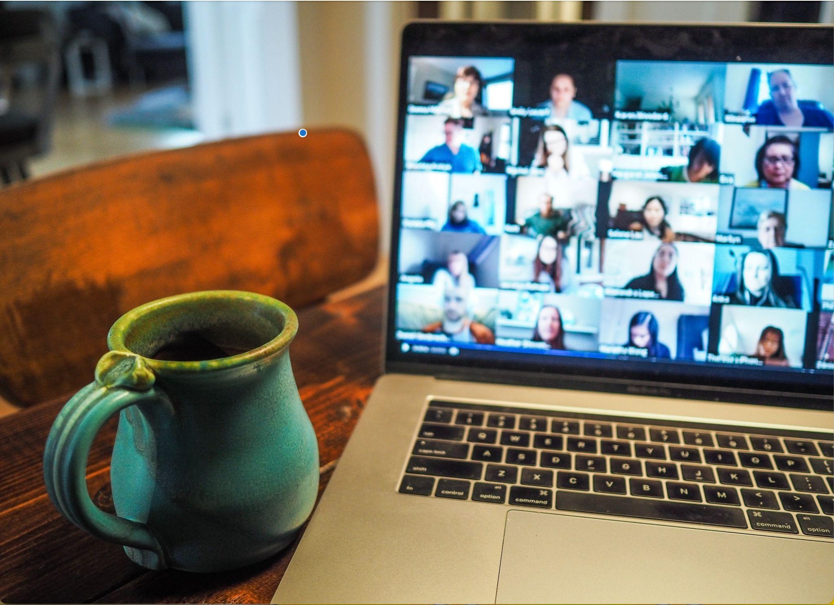
What Did We Gain?
Virtual engagement allowed us to reach folks when in-person was not an option, potentially more community members than before
We had the ability to share information with community members rapidly
We had digital tools to help track engagement
Photo credit: Chris Montgomery on Unsplash
Notes:
This point was included in the slide, but I’m not sure if you would like to keep it
Creates work/life balance for many internally/externally

Slide 13
What Did We Lose?
In-person relationship building and dialogue
The post-meeting, coffee conversations
Dynamic dialogue back and forth
Trust
Feeling of community
Photo credit: Chris Montgomery on Unsplash
Notes:
This point was included in the slide, but I’m not sure if you would like to keep it
Creates work/life balance for many internally/externally

Slide 14
Where Are We Now?
Burnout and public engagement fatigue
Virtual, In-person, and hybrid engagement
Notes:
2nd point: Giving people both virtual and in-person options to engage and participate in dialogue with local gov (kind of goes with “different parts of the community can engage in a different way”)
Not 100% about the last point

Slide 15
Renewed Focus
Need to return to the basics of public engagement, to dialogue as the foundation for relationship building between local governments and communities because dialogue:
Provides a holistic understanding of community thoughts and needs
Provides an opportunity to exchange ideas
Invites community members to be a part of the process
Builds trust
Creates space for engagement
Notes:
Joe B Example - MB

Slide 16
Dialogue is different based where you are on the public engagement spectrum!
Photo credit Pepperdine University
Notes:
-To replace image: click image. Click Replace Image. Select image to replace and insert. Update image credit.
Type of engagement and response varies depending on type of dialogue

Slide 17
The Public Engagement Spectrum

Slide 18
Public Engagement Spectrum
Communication

Slide 19
Definition of Stages

Slide 20
Facilitating Dialogue
Who needs to be “in the room”... at a stakeholder level
Citizens talk to citizens and we
listen and learn
Always use round tables, never a head table
All discussion happens at round tables
Randomly assign people to tables

Slide 21
Distractions in Dialogue
Photo credit Sam Gordon
SLOC–Sudden Loss of Credibility occurs when
Arrogance: “In my expert opinion”
Condescendence: “When you get a little older, you’ll have a much better understanding”/”If you were accountable to the bottom line, you’d understand..”
Political: “We all know that everyone thinks…”
Insulting: “You have no idea…” “It’s obvious you don’t care about…”
Power Play: “You deserve to be recalled.”
Notes:
-To replace image: click image. Click Replace Image. Select image to replace and insert. Update image credit.

Slide 22
Relationship Building
How Partnership Help Facilitate Dialogue

Slide 23
Cultivating Relationships Through Partnerships
Dialogue demonstrates care, interest, and a shared sense of responsibility in a community (common goals), but you can’t do it alone!
Conversations with community based organizations can help facilitate and cultivate dialogue with the broader community
Notes:
Joe B Example - MB

Slide 24
“Communication leads to community, that is, to understanding, intimacy and mutual valuing.” -Rollo May
Notes:
Rollo May was an influential American psychologist whose greatest contribution lies in his theory of human development.

Slide 25
Why Is This Important?
Bringing It All Together

Slide 26
It Is All Connected
Dialogue
Trust
Strong Community
Notes:
While one leads to the other, dialogue, trust, and strong communities are all connected and the spaces between them are fluid. It is important to understand that sometimes it does not always work out the way we anticipate or that the effectiveness of dialogue can vary based on the different aspects we discussed and the intangibles like major events in that community.

